Slide 1



Incident Reporting & Investigation Training
Notes:
"Hi everyone, and welcome to this Incident Reporting and Investigation Training.
Incident reporting and investigations are an essential part of any safety and security plan. This strategy supports risk management, ensures preventive measures are implemented , and promote accountability across all departments.
Every facility plays a critical role in maintaining a safe environment. When responding to any incident that involves Safety and security, proper reporting is necessary . It promtotes to reeduce the likelihood of recurrence and protect staff, clients, and assets.
By recognizing that safety is a shared responsibility, our ourganization can strengthen communication, improve response times, and foster a culture of safety and care
In this short training, we’re going to walk through:
What types of incidents need to be reported
How to access and complete an incident report
What to do if you’re assigned to investigate a report
How to write an investigation summary
How to close a report and send discharge or suspension alerts
The goal is to keep you informed and prepared — just the key things you need to know to handle incident reporting and investigations the right way at Housing Works."

Slide 2
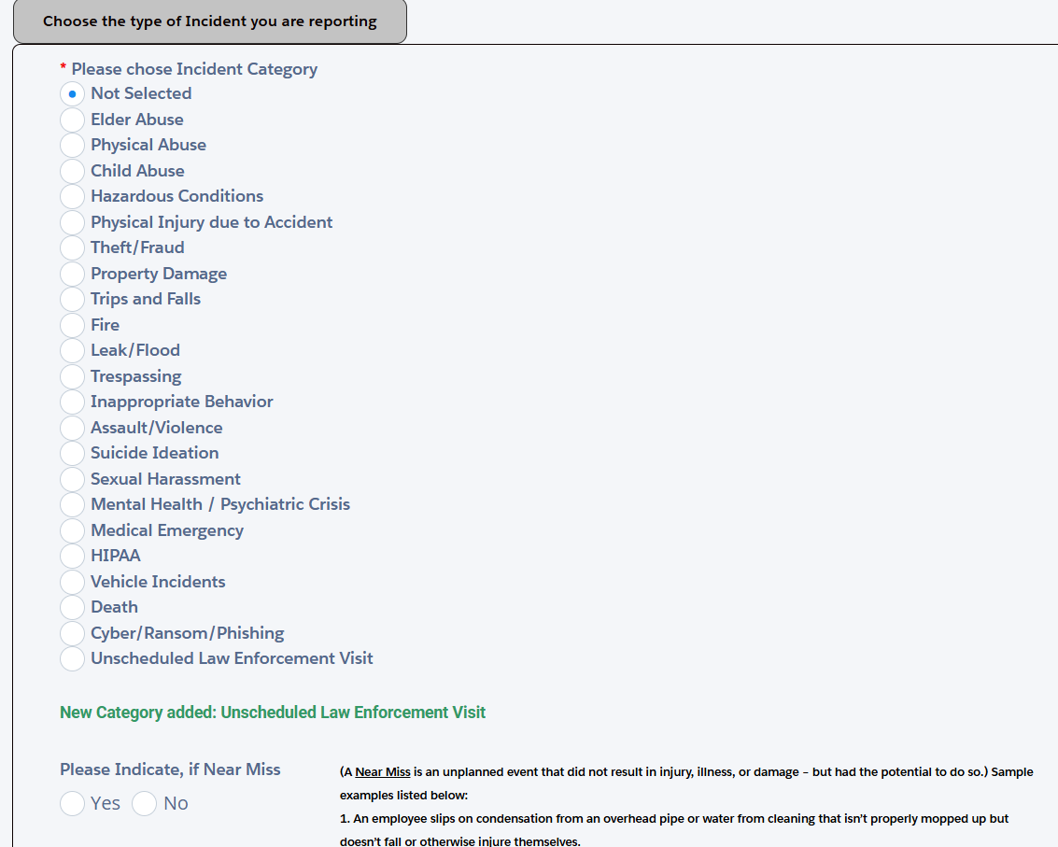


What is an Incident Report?
An incident report is a formal, factual record of an unexpected event that affects the safety or operations within a facility or program.
Incident Report Categories
Why does an Incident Report Matter?
What It Documents
When
We file incident reports to create a clear and accurate record of events that could impact the safety and well-being of clients, staff, or the facility.
How and What happened
Who was involved
Any immediate actions taken
Notes:
At Housing Works, an incident report is a formal, factual record of any unusual, disruptive, or emergency occurring at a facility. These include all safety and security concerns involving but are not limited to medical emergencies, safety hazards, property damage, theft/fraud, behaviroal health and even near misses. Any situation that put individuals or property at risk,
It’s important that we report it. reports are to be clear, objective, and accurate — sticking to the facts, not opinions or assumptions. Who was involved, how and what took place, when, and where — that’s the core of a strong report. Once submitted, supervisors review these reports to follow up with staff, provide support, or take corrective action if needed. But these reports also serve a purpose for emergency preparedness. As we track incidents over time we are able to identify patterns and trends — This data helps us create or adjust policies, improve staff training, and prevent similar incidents or near misses from happening again.
The incident reporting process is a foundational tool for risk management, organizational accountability, and the protection of everyone across all-sites

Slide 3



Do Nots When Filing Incident Report
When to Report
Do not wait for someone else to file it — if you saw it, experienced it, or were told about it, it’s your responsibility to report.
Immediately after, once the situation is safe
Don’t delay - delays can lead to missing or inaccurate details.
ALL incident reports should be filed within 24-48 hours
Don’t be afraid.. If you're unsure, report it anyway. It's always better to over-report than to miss something important.
Everyone at Housing Works has the duty to report an incident
Notes:
Now lets dive into when to report. When reporting an incident, Timing is essential not just for documentation, but for prevention, preparedness, and accountability. Any incident that impacts safety, security, or operations should be reported as soon as possible or after the situation is under control.
This includes:
Injuries or medical emergencies
Inappropriate behavior such as yelling, threats, or harassment
Theft or fraud
Property damage, vandalism, or unsafe conditions
Any situation that may present a risk or liability, including near misses
Reports should be submitted immediately or within 24 to 48 hours. Delayed reporting can lead to lost details, inadequate follow-up, and increased risk exposure.
If you witness, experience, or are informed of an incident — it is your responsibility to report it. Don’t assume someone else will. Multiple reports from different staff members are encouraged, as they help us as an agency improve.
Even if you're unsure whether something qualifies, it's always better to report than to miss something critical.

Slide 4

How Incident Reports Help Us
Improve training and procedures
Protect staff against liability
Identify trends and repeat behaviors
Support Disciplinary or Discharge Actions
Ensure Legal and Policy Compliance
Create Accountability and Transparency
Risk Management and Prevention
Notes:
First lets coverWhy incident reports matter: Incident reports matter because
They create a formal record that protects both the agency and staff by demonstrating appropriate response and due diligence.
They support legal accountability in case of audits, lawsuits, or investigations. They ensure staff are better prepared for future emergencies by learning from past events.
They help identify trends that lead to policy changes, training improvements, and prevention strategies. And
They also create accountability and transparency within our oragnization — not just for clients, but for staff and departments too. It shows that we’re responding to incidents and taking them seriously. good reporting helps us improve our training, staffing, and procedures.
So every report you write plays a part in making Housing Works safer and stronger.”

Slide 5
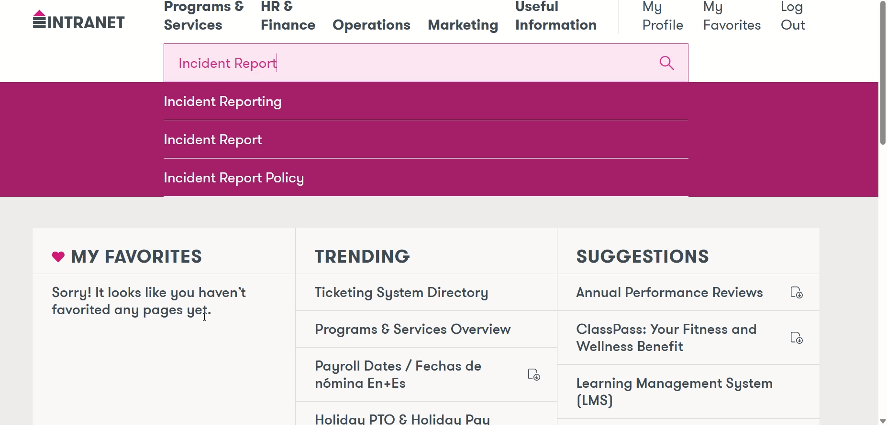
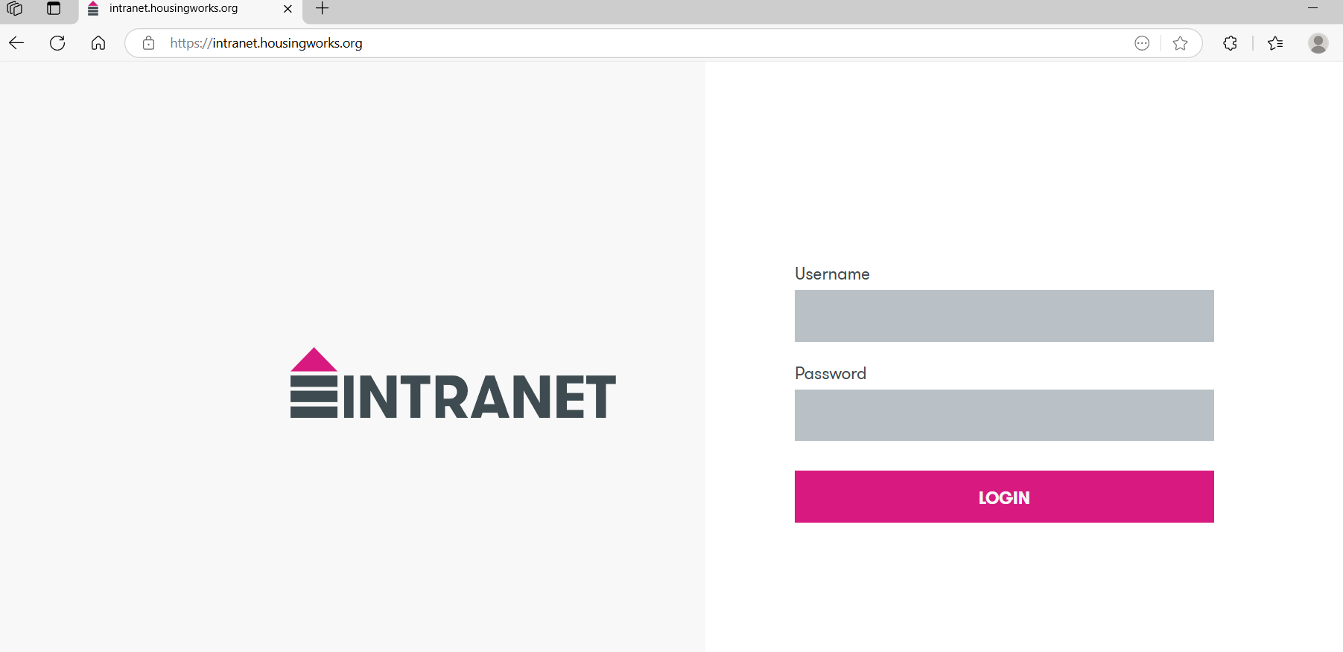
Where to File an Incident Report
Access via the Intranet/Lobby online intranet.housingworks.org
Notes:
To begin filing an incident report, you’ll start by going to the Housing Works intranet. You can access this from a work computer or from a desktop, which is available for staff use.
Once you're on the intranet homepage, use the search bar and type in ‘Reporting’.
Scroll down until you see a link that says: ‘Click here to submit a report.’
That link will take you to the internal reporting system, where you’ll complete the incident report form.
Make sure to fill out all sections of the form completely and accurately, including the incident type, people involved, date, location, and a clear summary of what occurred.
Submitting the report properly is the first step in keeping our teams informed and protected — so take the time to do it right.”

Slide 6
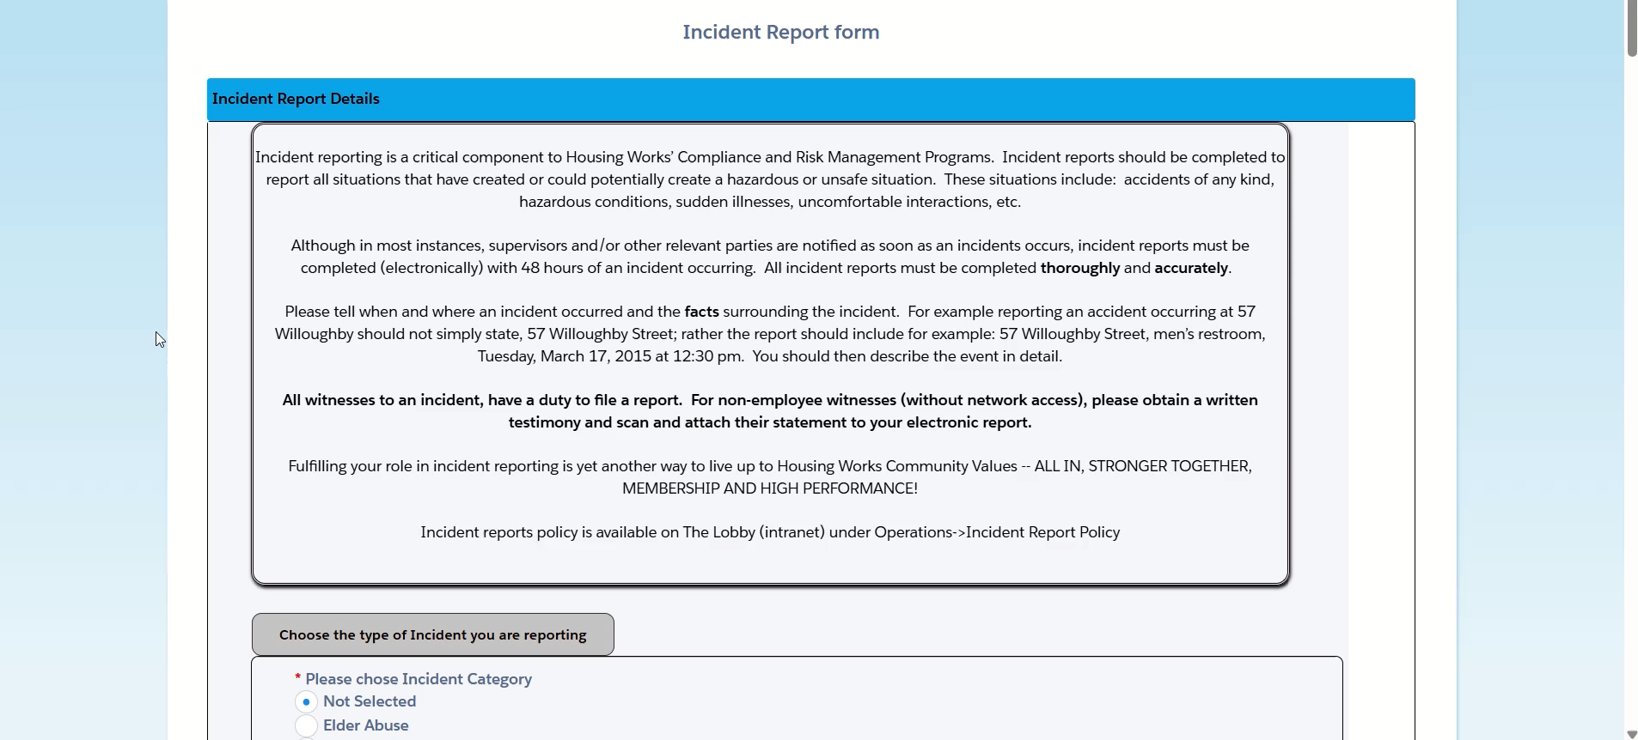
Incident Report Investigation
Once you selected a Category. Give as much information as possible
Notes:
“When filling out the incident report, start by selecting the correct incident category — as seen in the video there are many caetgories in which you can select from, so choose one to begin with your report.
After you select that category, it’s really important to give as much information as possible.
Include the full names of all people involved — clients, staff, witnesses — as well as the exact time and location.
Describe what happened in a clear, factual way. Stick to what you saw or what was said. Avoid adding opinions like 'I think he was high' — instead, describe what you observed: 'Client appeared disoriented, unsteady on feet, slurred speech.'
These details help the investigation process as we want to get all information necessary in order to move forward with the investigation.
So remember: once you pick the category — be thorough, clear, and objective.”

Slide 7

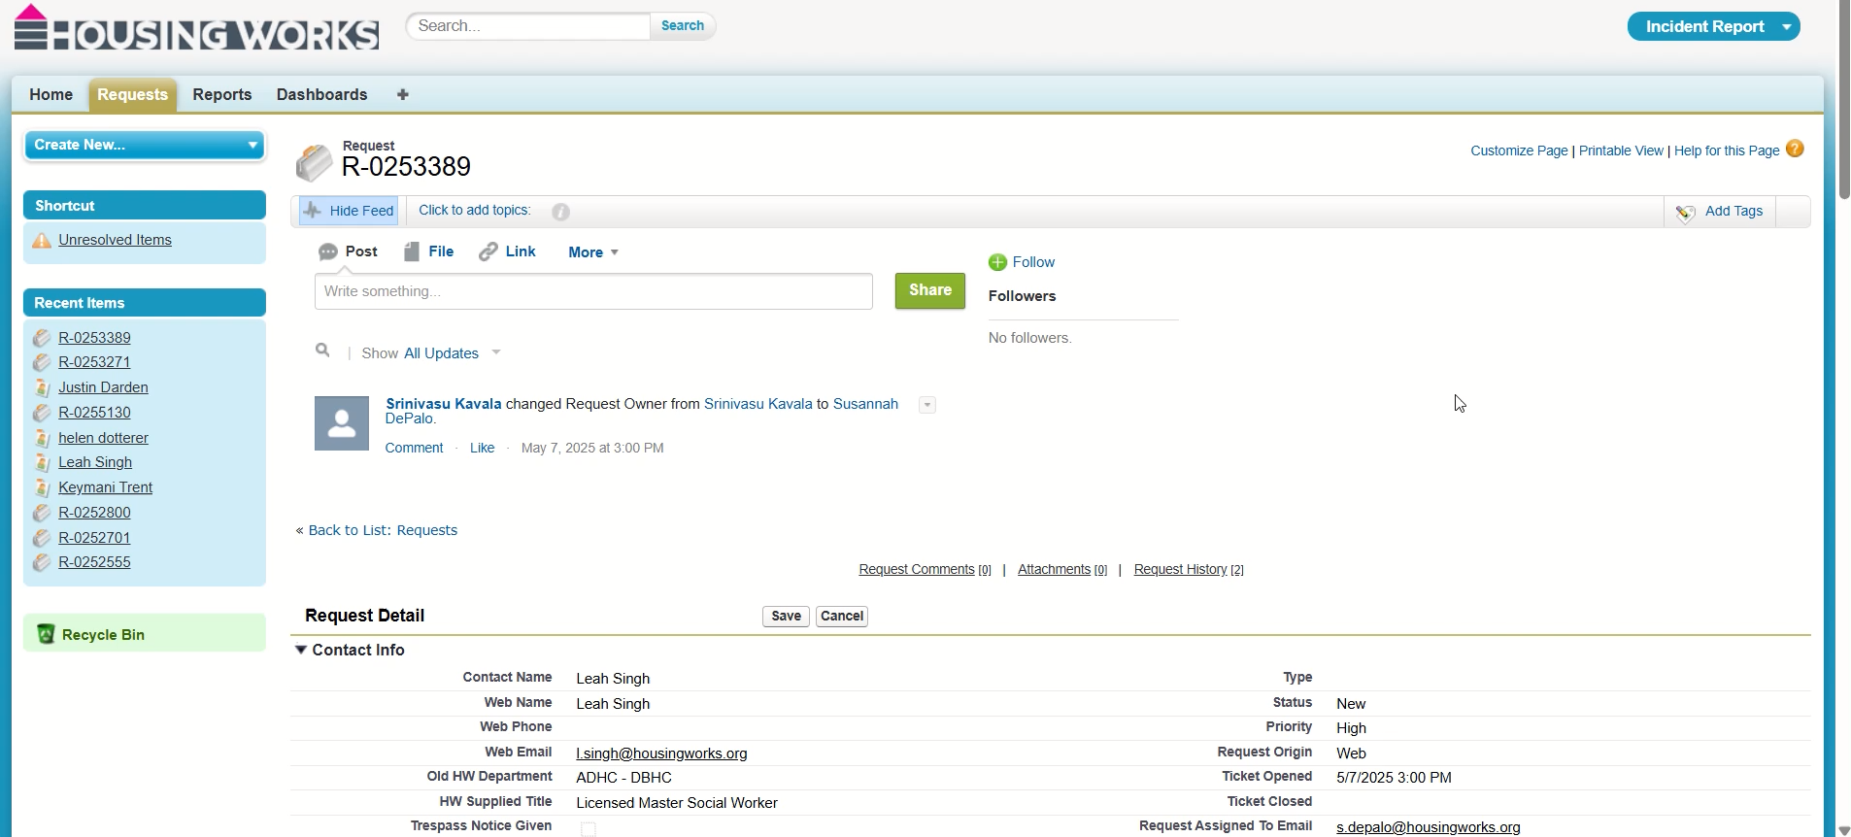
Accessing Report: Investigation
Access an Incident report via email notification or
http://Login.salesforce.com
Change Status of Incident to “In Progress” once received
Request to change the owner if necessary
Notes:
For staff assigned to investigate an incident, here’s how you access and take ownership of the report.
First, you’ll typically receive an email notification when a new report is submitted that requires your attention. You can also go directly to http://Login.salesforce.com and log in to your Housing Works account.
Once you locate the report, the first thing you should do is change the status to ‘In Progress.’ This signals to others that the investigation has started and prevents duplicate efforts.
If you are not the correct person to investigate the report, or if it was assigned to you in error, you can request that the report owner be changed. Reach out to your supervisor or the proper department to make that switch.
Once that’s set, you’re ready to start your review, gather facts, and move the investigation forward.”

Slide 8

Investigation Summary
When investigating read the full report carefully
Speak to all involved parties: staff/clients/officer
Review any supporting documents(Pictures, Camera Footage)
Get as much information as possible
Determine the Outcome
Note any policy violations, decisions made, and who approved
Notes:
“Once the report is assigned to you and marked as 'In Progress', your next step is to begin a full investigation and document a clear Investigation Summary.
Start by reading the entire report carefully, including all notes and details from the original submitter.
Then speak directly with everyone involved. That may include staff members, clients, or even other witnesses.
Next, gather and review any supporting documentation — this could include photos/ video footage or anything else that provides more context.
Your goal is to collect as much accurate information as possible.
Once you’ve gathered everything, determine the outcome. What happened? How did it happen? Why? And what’s the result?
Then document:
Whether any policies were violated,
What decisions were made,
This summary is what helps us understand the situation, and how we can move forward to continuing to keep everyone at Housing Works safe.

Slide 9

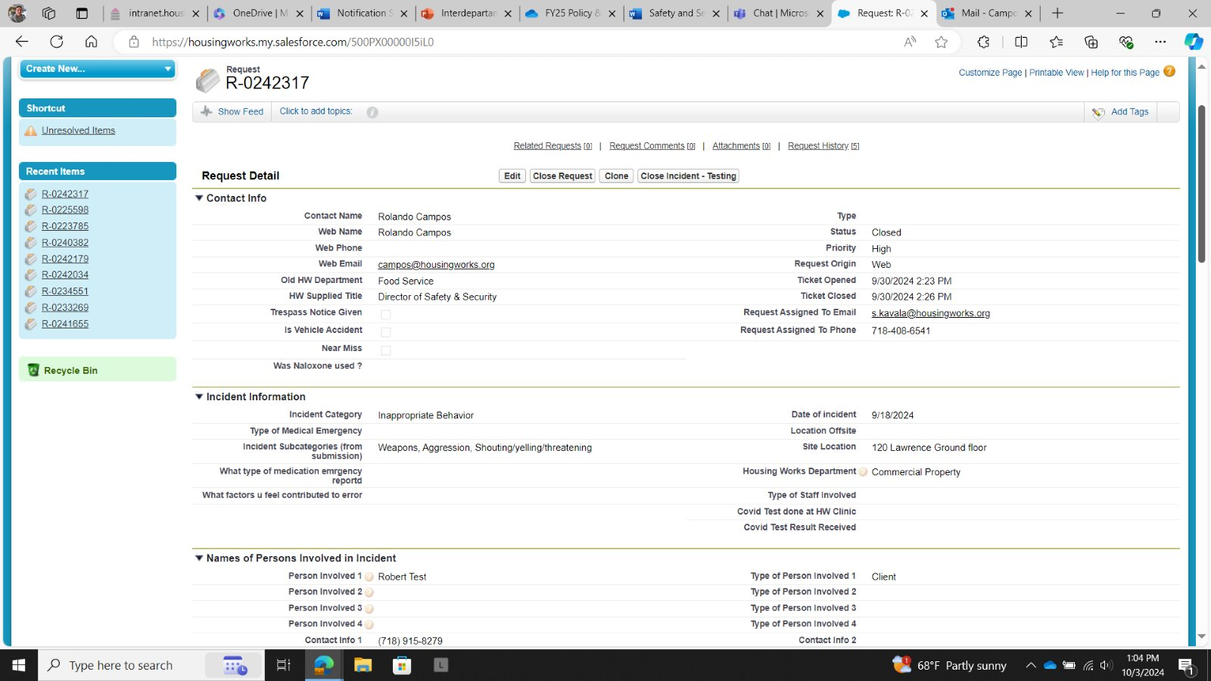
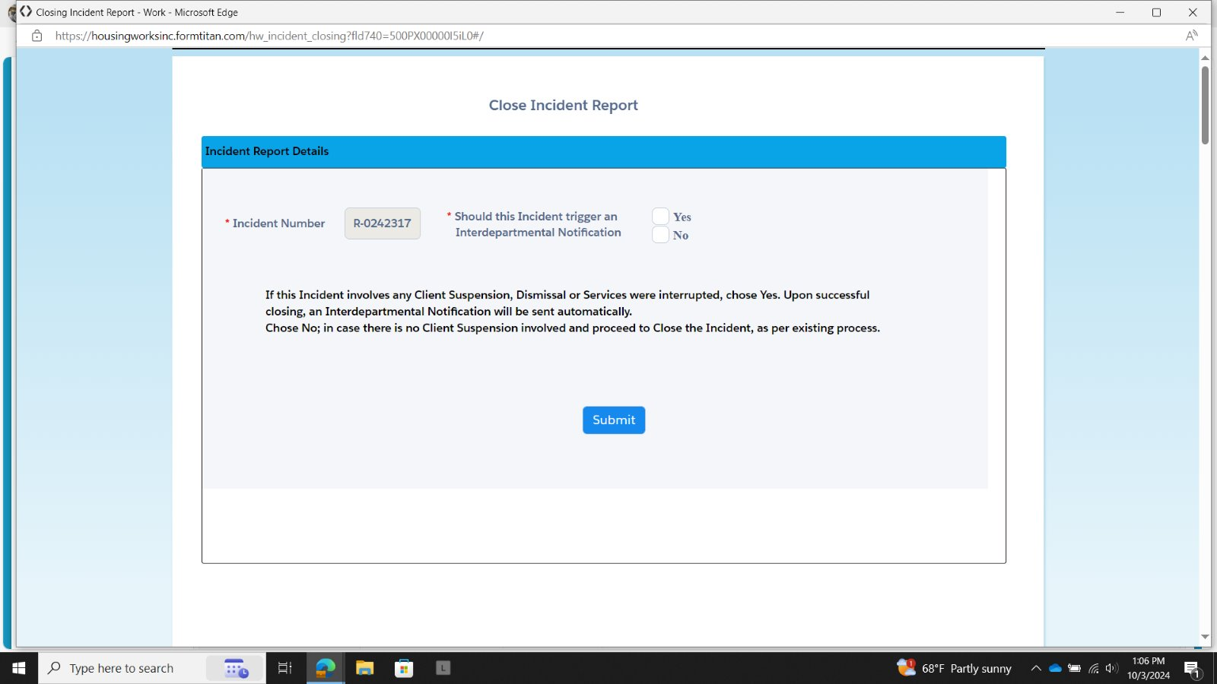
A determination needs to be made by the assigned staff member based on the report to verify if an emergency Meeting is needed. Case Manager, Director, Operations Manager, Etc play a role in this meeting.
Inter-Departmental Notification
This screen will show when a request to close an Incident Report is made.​
If the Incident Report results in a Dismissal, Reassignment or Suspension The “YES” box should be checked.
If so, the meeting is held with other stakeholders (other facility department/services) and a corrective action is decided in agreement by all stakeholders
Notes:
The investigation process is not just about reviewing what happened — it’s about taking coordinated action to reduce risk and prevent future incidents. This often means involving the right teams, holding the right meetings, and making sure all departments are aligned.
During an investigation, certain incidents require elevated attention and immediate coordination. When a situation is urgent and serious, the investigator may call for an Emergency Meeting. This is a critical step in our response process.
The Emergency Meeting brings together all involved departments — which may include security, case management, medical, and operations — to assess the risk, determine the facts, and make a unified decision on how to move forward. they are reserved for situations where the safety and security of the agency could be compromised.
Outcomes of these meetings may include:
Temporary or permanent suspension of services
Discharge from the facility
corrective actions such as a code of conduct
This coordinated approach ensures decisions are made with input from all stakeholders and helps protect the agency.
After a decision is made, when closing a report if necessary a Interdepartmental Notification is sent out agency wide including a suspension, discharge, or referral via email. This ensures that all frontline staff, support services, and relevant departments are aware and informed, preventing breakdowns in communication that can lead to safety issues or liability.
Before closing an investigation, always note in your report if a meeting was held, what departments were involved, and any actions taken and if a Interdepartmental Notification is necessary. This transparency reinforces accountability and supports long-term safety planning and documentation.

Slide 10

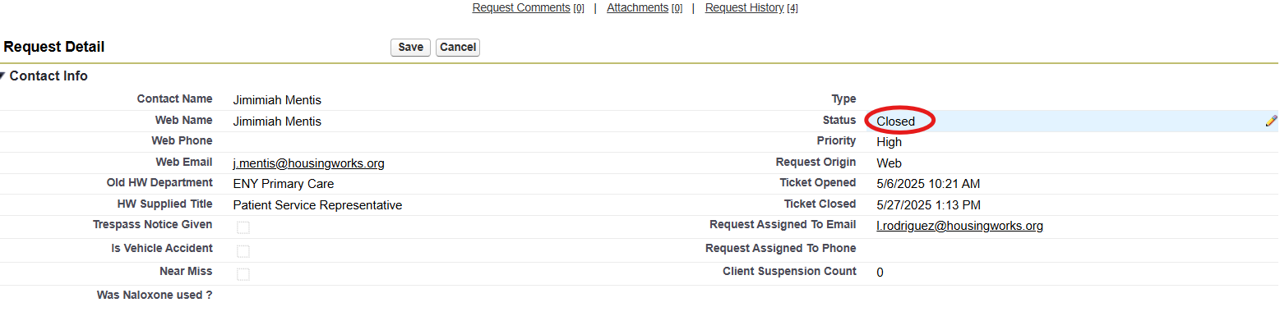
Closing Incident Reports
Close Incident Reports within 30 Days
Document actions: suspension, discharge, follow-up. Corrective Actions/recommendations
If yes, all Housing Works departments will be notified of discharge or suspension of services and from which programs
Notes:
“Let’s go over the final step in the process — closing the incident report.
Our goal is to have all reports closed within 30 days of the original submission date. That helps ensure timely follow-up, accountability, and accurate recordkeeping.
When closing the report, it’s important to clearly document all actions taken especially if a meeting was held and what procedures followed.
You should also include any corrective actions or recommendations, such as training refreshers, policies you would like to see updated, or any other concerns Safety and security related.
it’s critical that all departments at Housing Works are notified.
This ensures no gaps in communication agency wide and sets a standard for the safety and security of all. The closing summary should be professional, clear, and reflect the outcome of your investigation and the decisions made.

Slide 11

Incident Reporting & Investigation Summary
Do not delay report submission, leaving fields blank, using vague terms
Follow up on investigation/summary, communicate to those involved
Use SalesForce to access Incident Reports
Close Reports- All Reports Closed within 30 days
Thank you for keeping yourself and others safe here at Housing Works
Notes:
“To wrap up this training, here are a few key reminders to take with you:
Why are incidents reports important. They help us continue to track trends which lead to improved trainings, policies, and keep the integrity of safety and security at high.
Do not delay submitting an incident report. It should be entered as soon as possible, ideally right after the situation is safe.
When writing your report, do not leave any fields blank and avoid using vague or unclear terms like ‘acted weird’ or ‘seemed off.’ Be detailed and objective.
Once an investigation is started, follow through. That includes writing the Investigation Summary, attending any required meetings, and communicating outcomes with those involved.
All reports must be accessed and tracked through Salesforce. That’s the system we use across Housing Works, and it ensures we’re all working off the same information.
And finally, remember that all incident reports should be closed within 30 days. This helps us stay compliant, responsive, and accountable as an agency.
If you ever have questions, reach out to your supervisor or the safety and security department. Thank you for doing your part in keeping Housing Works safe.”

Slide 12
Any questions? Feel free to reach out to us!
Safety and Security Director: Rolando Campos campos@housingworks.org
Safety and Security Specialist:
Jarred Marrow j.marrow@housingworks.org
Notes:
“Thanks again for taking the time to complete this training.
As a reminder — if you ever feel unsure about whether to report something, report it anyway. It’s always better to speak up.
If you have questions or need support at any point during an incident or investigation process, don’t hesitate to reach out to Safety and Security Specialist Jarred Marrow or our Director of Safety and Security, Rolando Campos.
We’re here to support you — and your actions help us protect both clients and staff.
Thank you for your attention and commitment to safety at Housing Works.”

